Slide 1
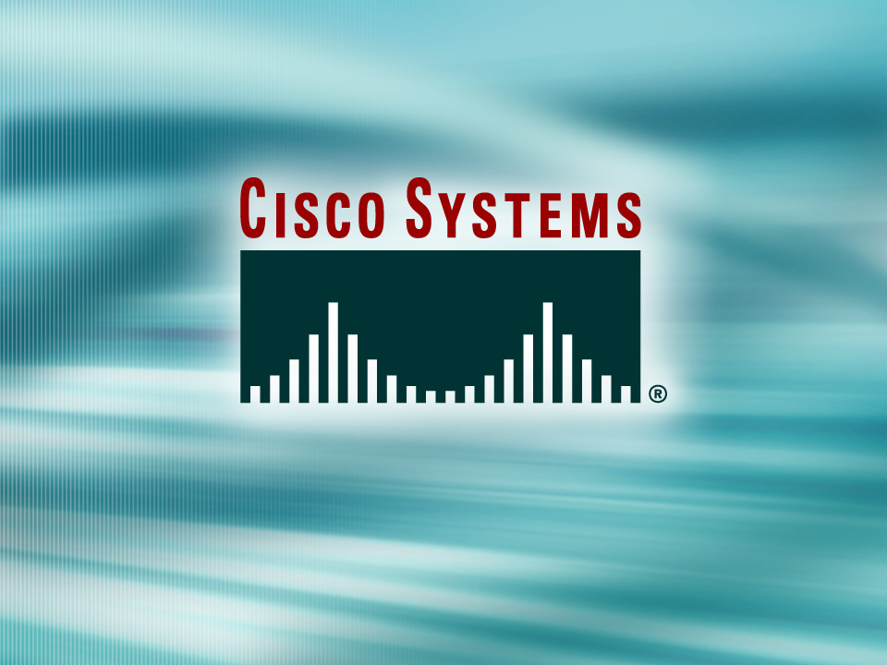
© 2002, Cisco Systems, Inc. All rights reserved.

Slide 2

Scaling the Network with
NAT and PAT
© 2002, Cisco Systems, Inc. All rights reserved.
Notes:
Purpose: This chapter introduces the Cisco IOS™ CLI on the Catalyst® 1900 switch and router.
Timing: This chapter should take about 2 hours to present.
Note: The Catalyst 1900 switch only has a subset of the router Cisco IOS commands available.
Contents:
Introduction to Cisco IOS. Explain to the student what is IOS?
Cisco Device startup procedures in general.
IOS configuration source.
General introduction to the IOS CLI.
Cat 1900 switch startup procedures.
Intro to Cat 1900 CLI. This part covers the basic configuration on the switch, like setting the IP address and hostname. More details about the various Cat 1900 switch configuration commands are explained in Chapter 6 and 7.
Router startup procedures. More details on the router startup process is discussed in chapter 5.
Router IOS CLI.

Slide 3
Objectives
Upon completing this lesson, you will be able to:
  Describe the features and operation of NAT on Cisco routers
  Use Cisco IOS commands to configure NAT, given a functioning router
  Use show commands to identify anomalies in the NAT configuration, given an operational router
  Use debug commands to identify events and anomalies in the NAT configuration, given an operational router
Notes:
Slide 1 of 2
Purpose: This slide states the chapter objectives.
Emphasize: Read or state each objective so that each student has a clear understanding of the chapter objectives.
Note: Catalyst switches have different CLIs. The Catalyst 2900xl and the Catalyst 1900 has a Cisco IOS CLI. The Cisco IOS CLI commands available on the 2900xl is different from the 1900. The Catalyst 5000 family has no Cisco IOS CLI, and use the set commands instead. This class only covers the configuration on the Catalyst 1900 switch.

Slide 4
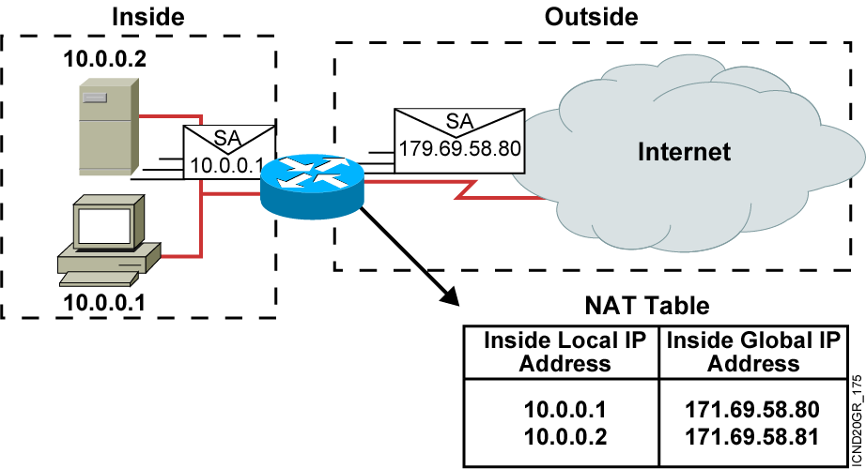
Network Address Translation
An IP address is either local or global.
Local IP addresses are seen in the inside network.

Slide 5
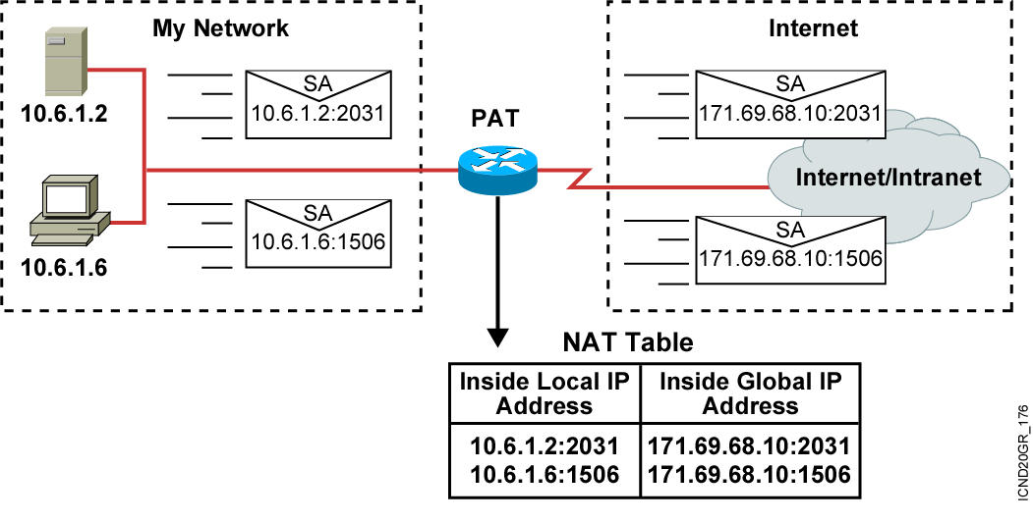
Port Address Translation

Slide 6
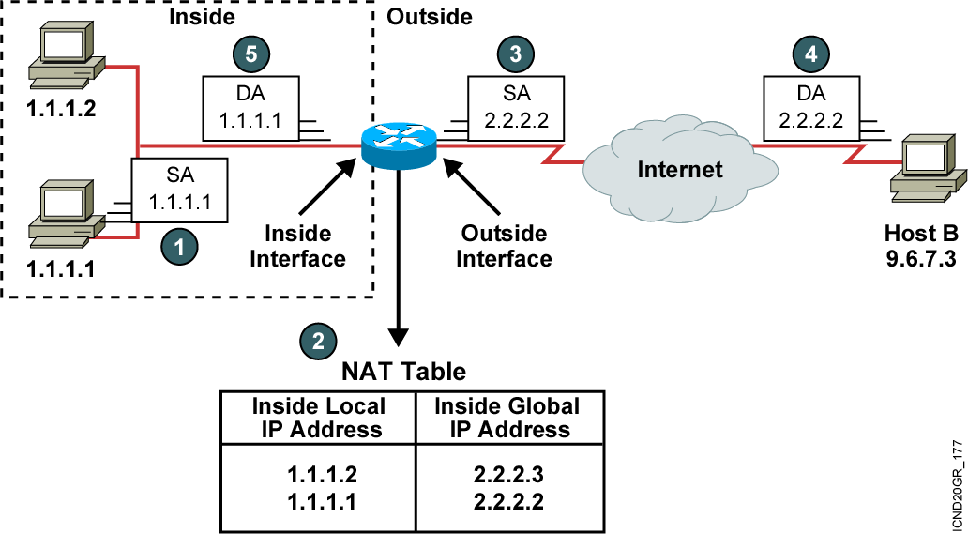
Translating Inside Source Addresses

Slide 7
Configuring Static Translation
Router(config)#ip nat inside source static local-ip global-ip
  Establishes static translation between an inside local address and an inside global address
Router(config-if)#ip nat inside
  Marks the interface as connected to the inside
Router(config-if)#ip nat outside
  Marks the interface as connected to the outside

Slide 8
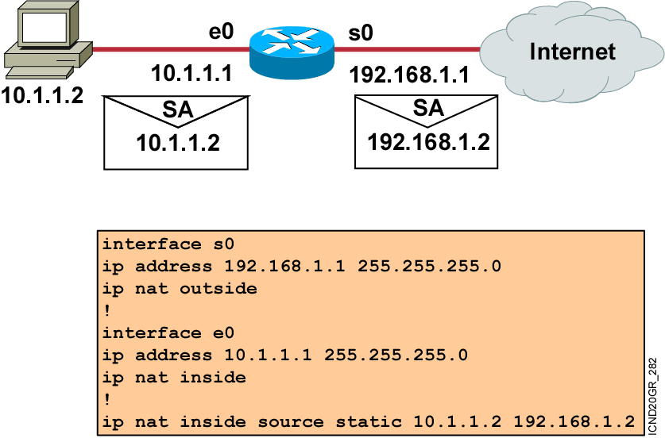
Enabling Static NAT
Address Mapping Example

Slide 9
Configuring Dynamic Translation
Router(config)#ip nat pool name start-ip end-ip
{netmask netmask | prefix-length prefix-length}
  Defines a pool of global addresses to be allocated as needed
Router(config)#access-list access-list-number permit
source [source-wildcard]
  Defines a standard IP access list permitting those inside local addresses that are to be translated
Router(config)#ip nat inside source list
access-list-number pool name
  Establishes dynamic source translation, specifying the access list defined in the prior step

Slide 10
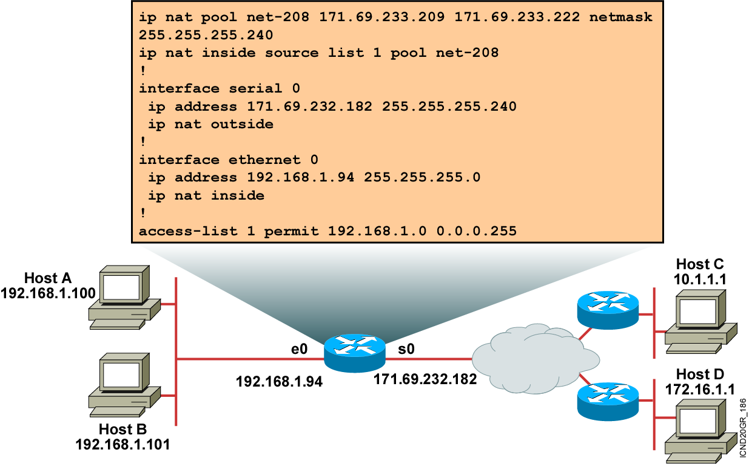
Dynamic Address Translation Example

Slide 11
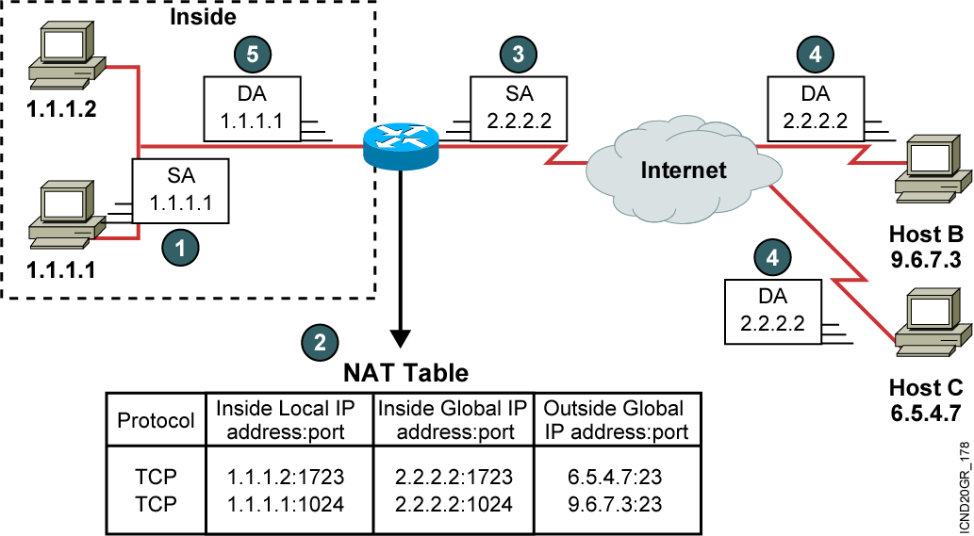
Overloading an Inside Global Address

Slide 12
Configuring Overloading
Router(config)#access-list access-list-number permit
source source-wildcard
  Defines a standard IP access list permitting those inside local addresses that are to be translated
Router(config)#ip nat inside source list
access-list-number interface interface overload
  Establishes dynamic source translation, specifying the access list defined in the prior step

Slide 13
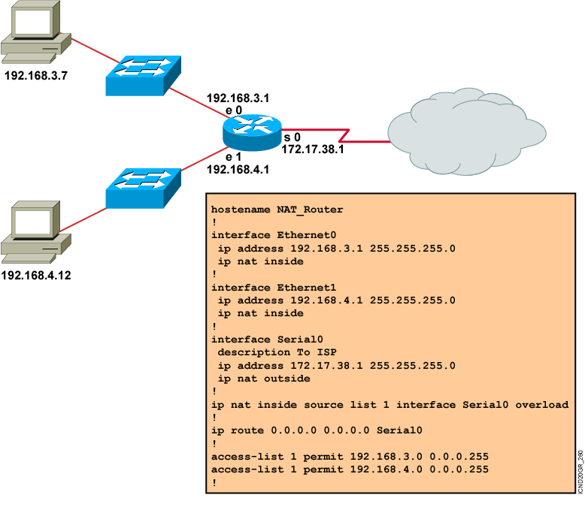
Overloading an Inside
Global Address Example

Slide 14
Clearing the NAT Translation Table
Router#clear ip nat translation *
  Clears all dynamic address translation entries
Router#clear ip nat translation inside global-ip
local-ip [outside local-ip global-ip]
  Clears a simple dynamic translation entry containing an inside translation, or both inside and outside translation
Router#clear ip nat translation outside
local-ip global-ip
  Clears a simple dynamic translation entry containing an outside translation
Router#clear ip nat translation protocol inside global-ip
global-port local-ip local-port [outside local-ip
local-port global-ip global-port]
  Clears an extended dynamic translation entry

Slide 15
Displaying Information with show Commands
Router#show ip nat translations
  Displays active translations
Router#show ip nat translation
Pro Inside global Inside local Outside local Outside global
--- 172.16.131.1 10.10.10.1 --- ---
Router#show ip nat statistics
  Displays translation statistics
Router#show ip nat statistics
Total active translations: 1 (1 static, 0 dynamic; 0 extended)
Outside interfaces:
Ethernet0, Serial2.7
Inside interfaces:
Ethernet1
Hits: 5 Misses: 0
…

Slide 16
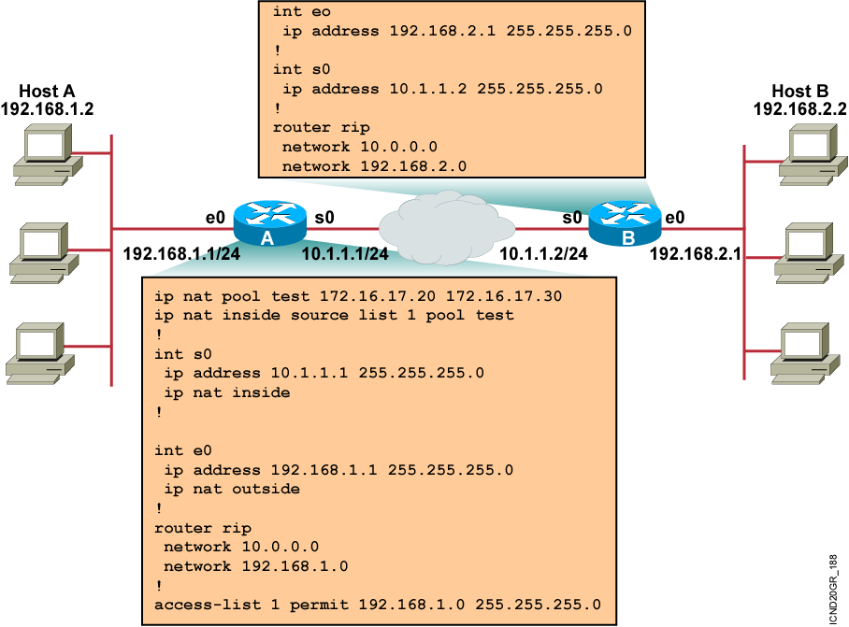
Sample Problem: Cannot
Ping Remote Host

Slide 17
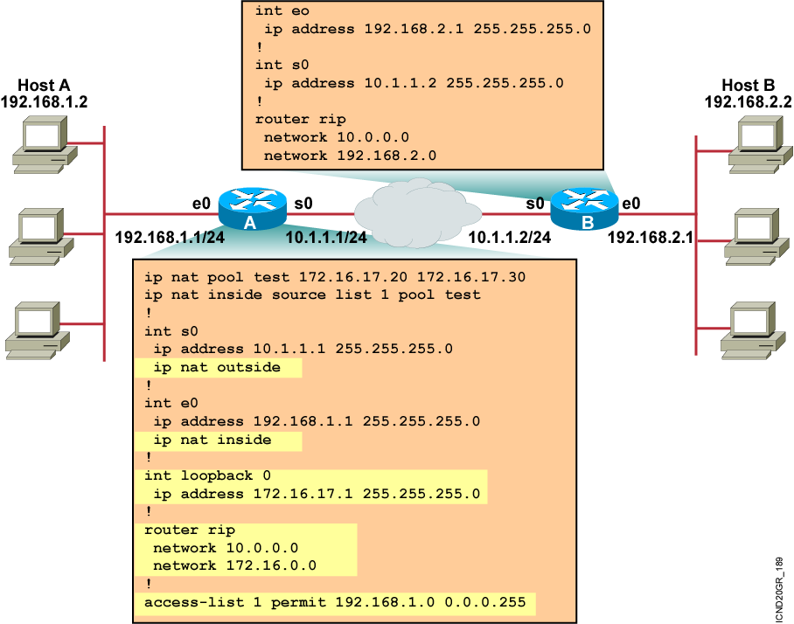
Solution: New Configuration

Slide 18
Using the debug ip nat Command
Router#debug ip nat
NAT: s=192.168.1.95->172.31.233.209, d=172.31.2.132 [6825]
NAT: s=172.31.2.132, d=172.31.233.209->192.168.1.95 [21852]
NAT: s=192.168.1.95->172.31.233.209, d=172.31.1.161 [6826]
NAT*: s=172.31.1.161, d=172.31.233.209->192.168.1.95 [23311]
NAT*: s=192.168.1.95->172.31.233.209, d=172.31.1.161 [6827]
NAT*: s=192.168.1.95->172.31.233.209, d=172.31.1.161 [6828]
NAT*: s=172.31.1.161, d=172.31.233.209->192.168.1.95 [23313]
NAT*: s=172.31.1.161, d=172.31.233.209->192.168.1.95 [23325]

Slide 19
Translation Not Installed in the Translation Table?
  Verify that:
    The configuration is correct.
    There are not any inbound access lists denying the packets from entering the NAT router.
    The access list referenced by the NAT command is permitting all necessary networks.
    There are enough addresses in the NAT pool.
    The router interfaces are appropriately defined as NAT inside or NAT outside.

Slide 20
Summary
  Cisco IOS NAT allows an organization with unregistered private addresses to connect to the Internet by translating those addresses into globally registered IP addresses.
  You can translate your own IP addresses into globally unique IP addresses when communicating outside of your network.
  Overloading is a form of dynamic NAT that maps multiple unregistered IP addresses to a single registered IP address (many-to-one) by using different ports, known also as PAT.
  Once you have configured NAT, verify that it is operating as expected using the clear and show commands.
  Sometimes NAT is blamed for IP connectivity problems when there is actually a routing problem.
Notes:
Purpose: This slide discuss the initial configurations on the routers and switches.
Note: There is no setup mode on the Catalyst 1900 switch.

Slide 21
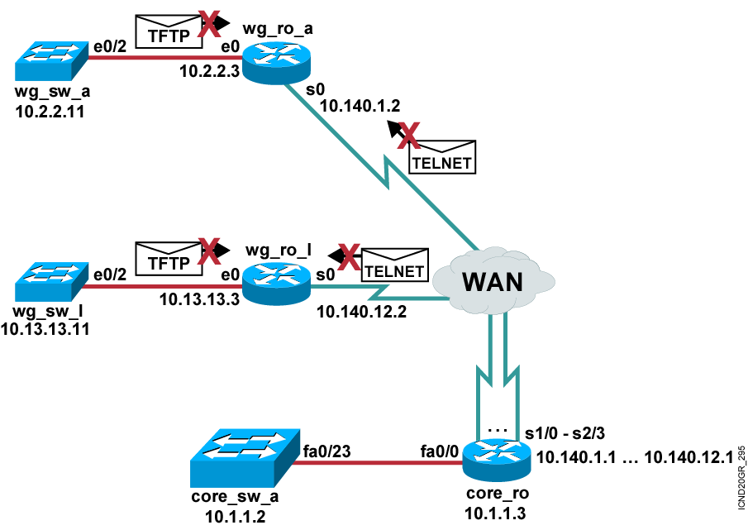
Visual Objective 6-1: Configuring
IP Access Lists
Workgroup Workgroup Workgroup
Pod Router s0 Router e0 Switch
A 10.140.1.2 10.2.2.3 10.2.2.11
B 10.140.2.2 10.3.3.3 10.3.3.11
C 10.140.3.2 10.4.4.3 10.4.4.11
D 10.140.4.2 10.5.5.3 10.5.5.11
E 10.140.5.2 10.6.6.3 10.6.6.11
F 10.140.6.2 10.7.7.3 10.7.7.11
G 10.140.7.2 10.8.8.3 10.8.8.11
H 10.140.8.2 10.9.9.3 10.9.9.11
I 10.140.9.2 10.10.10.3 10.10.10.11
J 10.140.10.2 10.11.11.3 10.11.11.11
K 10.140.11.2 10.12.12.3 10.12.12.11
L 10.140.12.2 10.13.13.3 10.13.13.11
Notes:
Lab 13 ACL
Note: Refer to the lab setup guide for lab instructions.

Slide 22
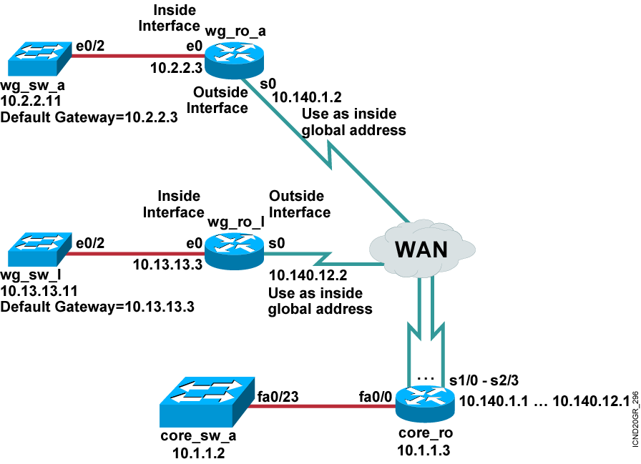
Visual Objective 6-2: Configuring Port Address Translation
Workgroup Workgroup Workgroup
Pod Router s0 Router e0 Switch
A 10.140.1.2 10.2.2.3 10.2.2.11
B 10.140.2.2 10.3.3.3 10.3.3.11
C 10.140.3.2 10.4.4.3 10.4.4.11
D 10.140.4.2 10.5.5.3 10.5.5.11
E 10.140.5.2 10.6.6.3 10.6.6.11
F 10.140.6.2 10.7.7.3 10.7.7.11
G 10.140.7.2 10.8.8.3 10.8.8.11
H 10.140.8.2 10.9.9.3 10.9.9.11
I 10.140.9.2 10.10.10.3 10.10.10.11
J 10.140.10.2 10.11.11.3 10.11.11.11
K 10.140.11.2 10.12.12.3 10.12.12.11
L 10.140.12.2 10.13.13.3 10.13.13.11
Notes:
Lab 13 ACL
Note: Refer to the lab setup guide for lab instructions.

Slide 23


